Slide 1
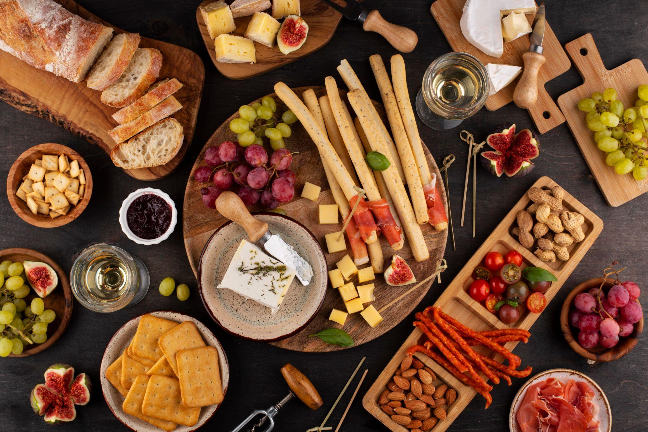

(New Restaurants Opening) Data Analysis
By: Aadarsh Katiyar

Slide 2
Contents
Summary
Suggested Countries
Lesser Competition
Cities in Suggested Countries
Ratings in Suggested Countries
Total Expenditure on Foods
Biggest Competitors in Suggested Countries
Choice of Cuisines
Mode of Bookings
Dashboard

Slide 3
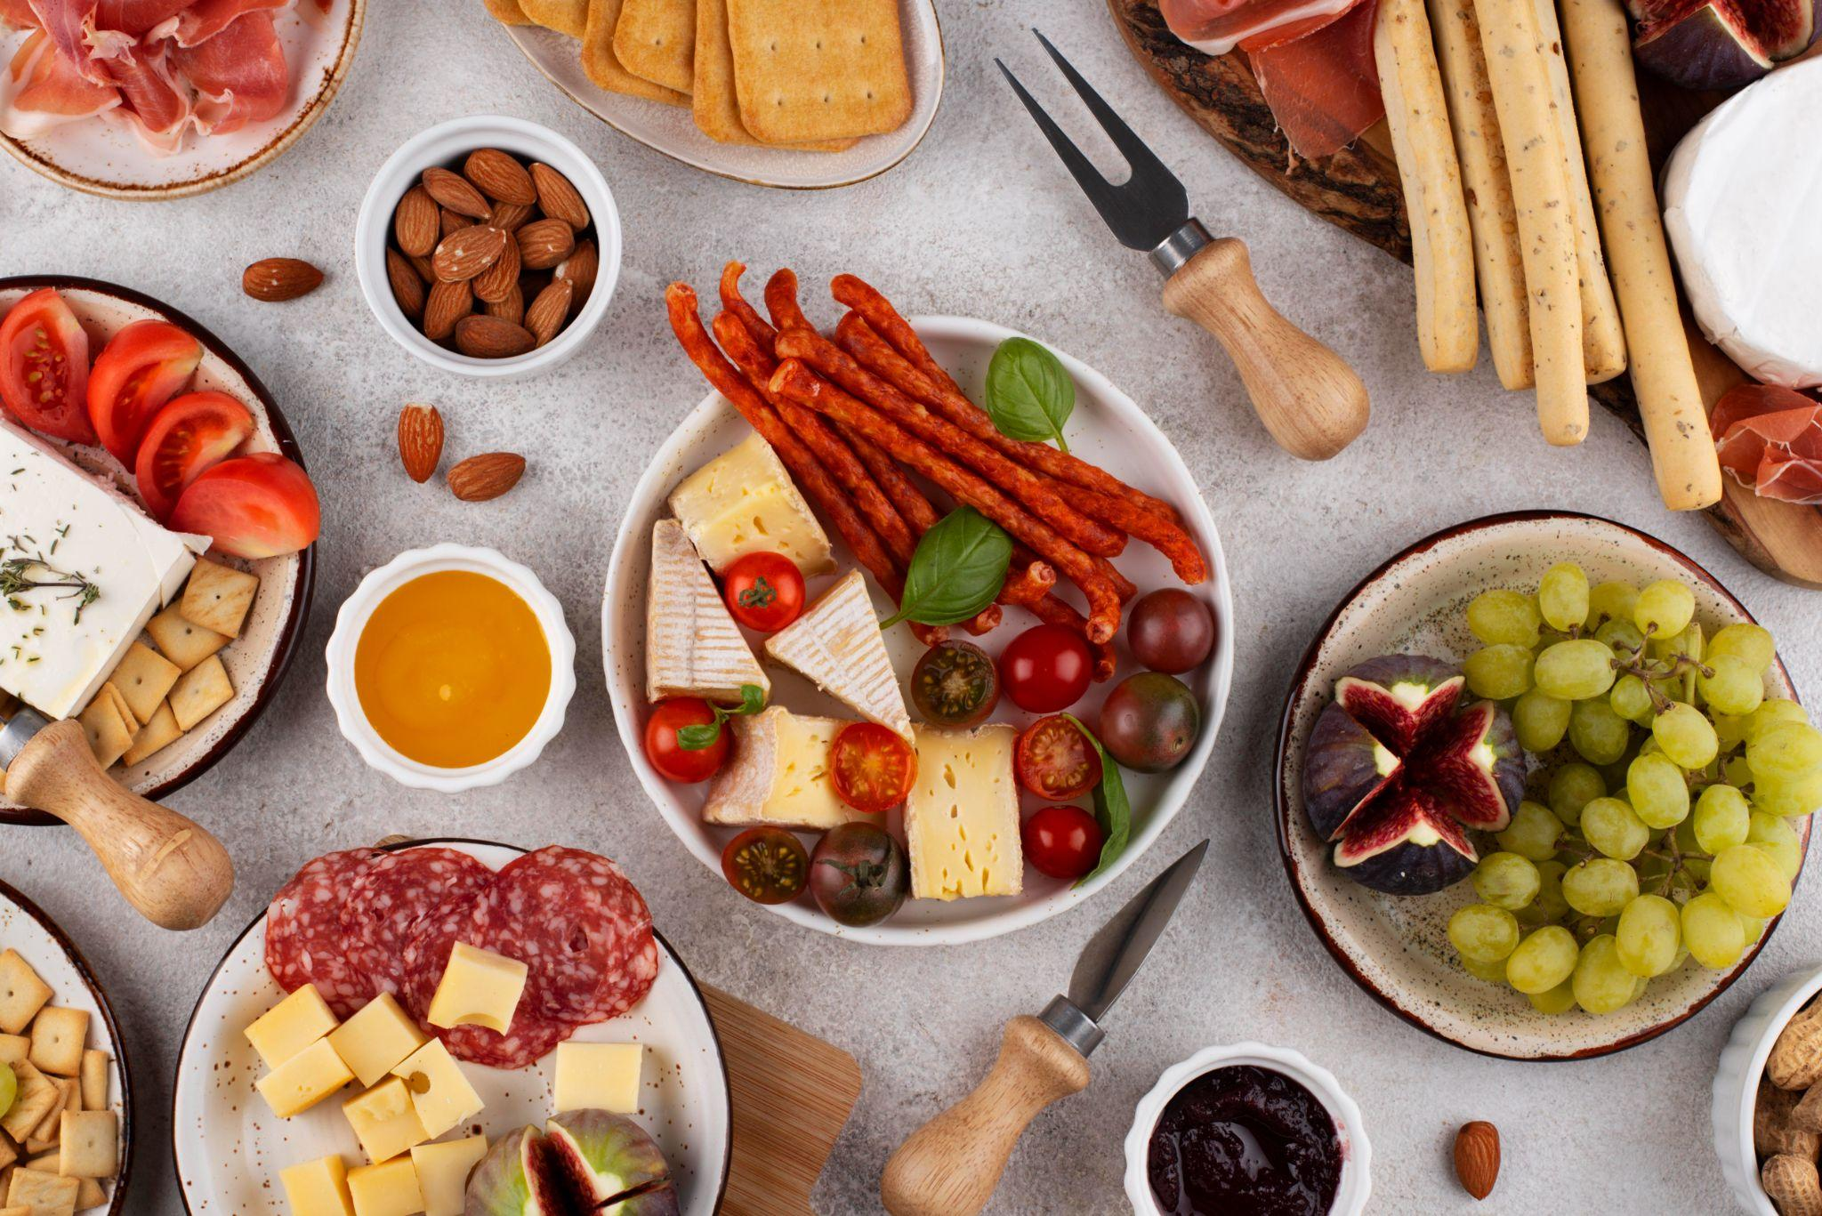
Summary
My extensive analysis, conducted as a consultant data analyst for Zomato, shows a number of essential strategic requirements for the opening of new restaurants. Market segmentation according to user preferences and demographic trends provides a sophisticated way to customize restaurant services to particular customer segments, maximizing success across a range of locations. By utilizing location information, it is possible to identify places with strong demand and minimal competition, which makes it easier to choose great locations that will optimize foot traffic and visibility. Developing menus and making operational enhancements to improve the whole eating experience is made possible by a foundation of insightful analysis of Zomato customer feedback and cuisine trends. Lastly, a thorough plan for profitable restaurant expansion includes considerations for sustainable practices and a varied menu to meet changing customer tastes.

Slide 4





Suggested Countries
Australia
Qatar
Canada
Singapore
Indonesia

Slide 5
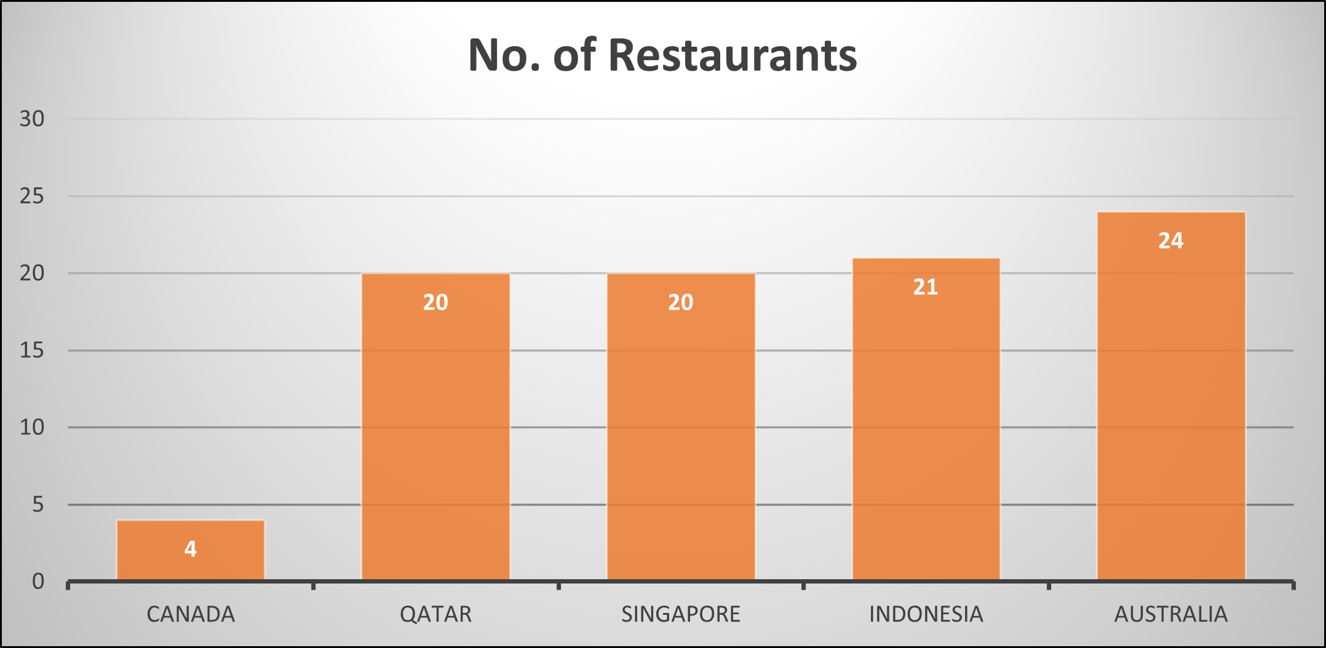
Lesser Competetion
Less Number of Restaurants Opened
The countries having less number of Restaurants are having lesser competition as compared to the countries having more number of restaurants. According to the analysis it has been found that Australia, Canada, Qatar, Indonesia and Singapore are having less number of restaurants.

Slide 6
Cities in Suggested Countries
Australia
Indonesia
The cities with the lowest ratings are the most suitable for the opening of new restaurants.
Balingup
Mayfield
Montville
Paynesville
Penola
Bogor
Qatar
Doha
Canada
Singapore
Consort
Yorkton
Singapore

Slide 7

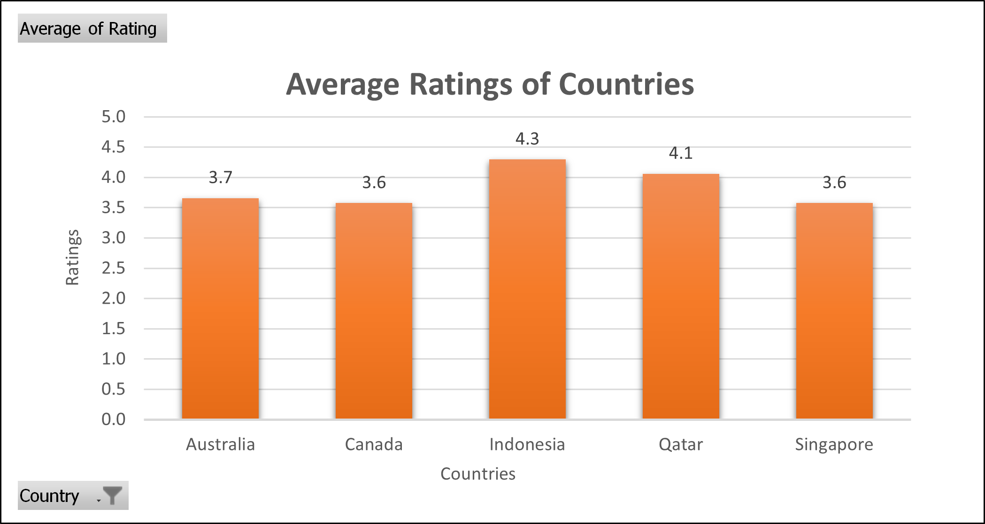
Ratings in the Suggested Countries
Basis of the data the Average Ratings in the suggested countries were between 3.5 to 4.5 which indicates that there were restaurants which were moderately good to moderately unfavorable ratings.

Slide 8

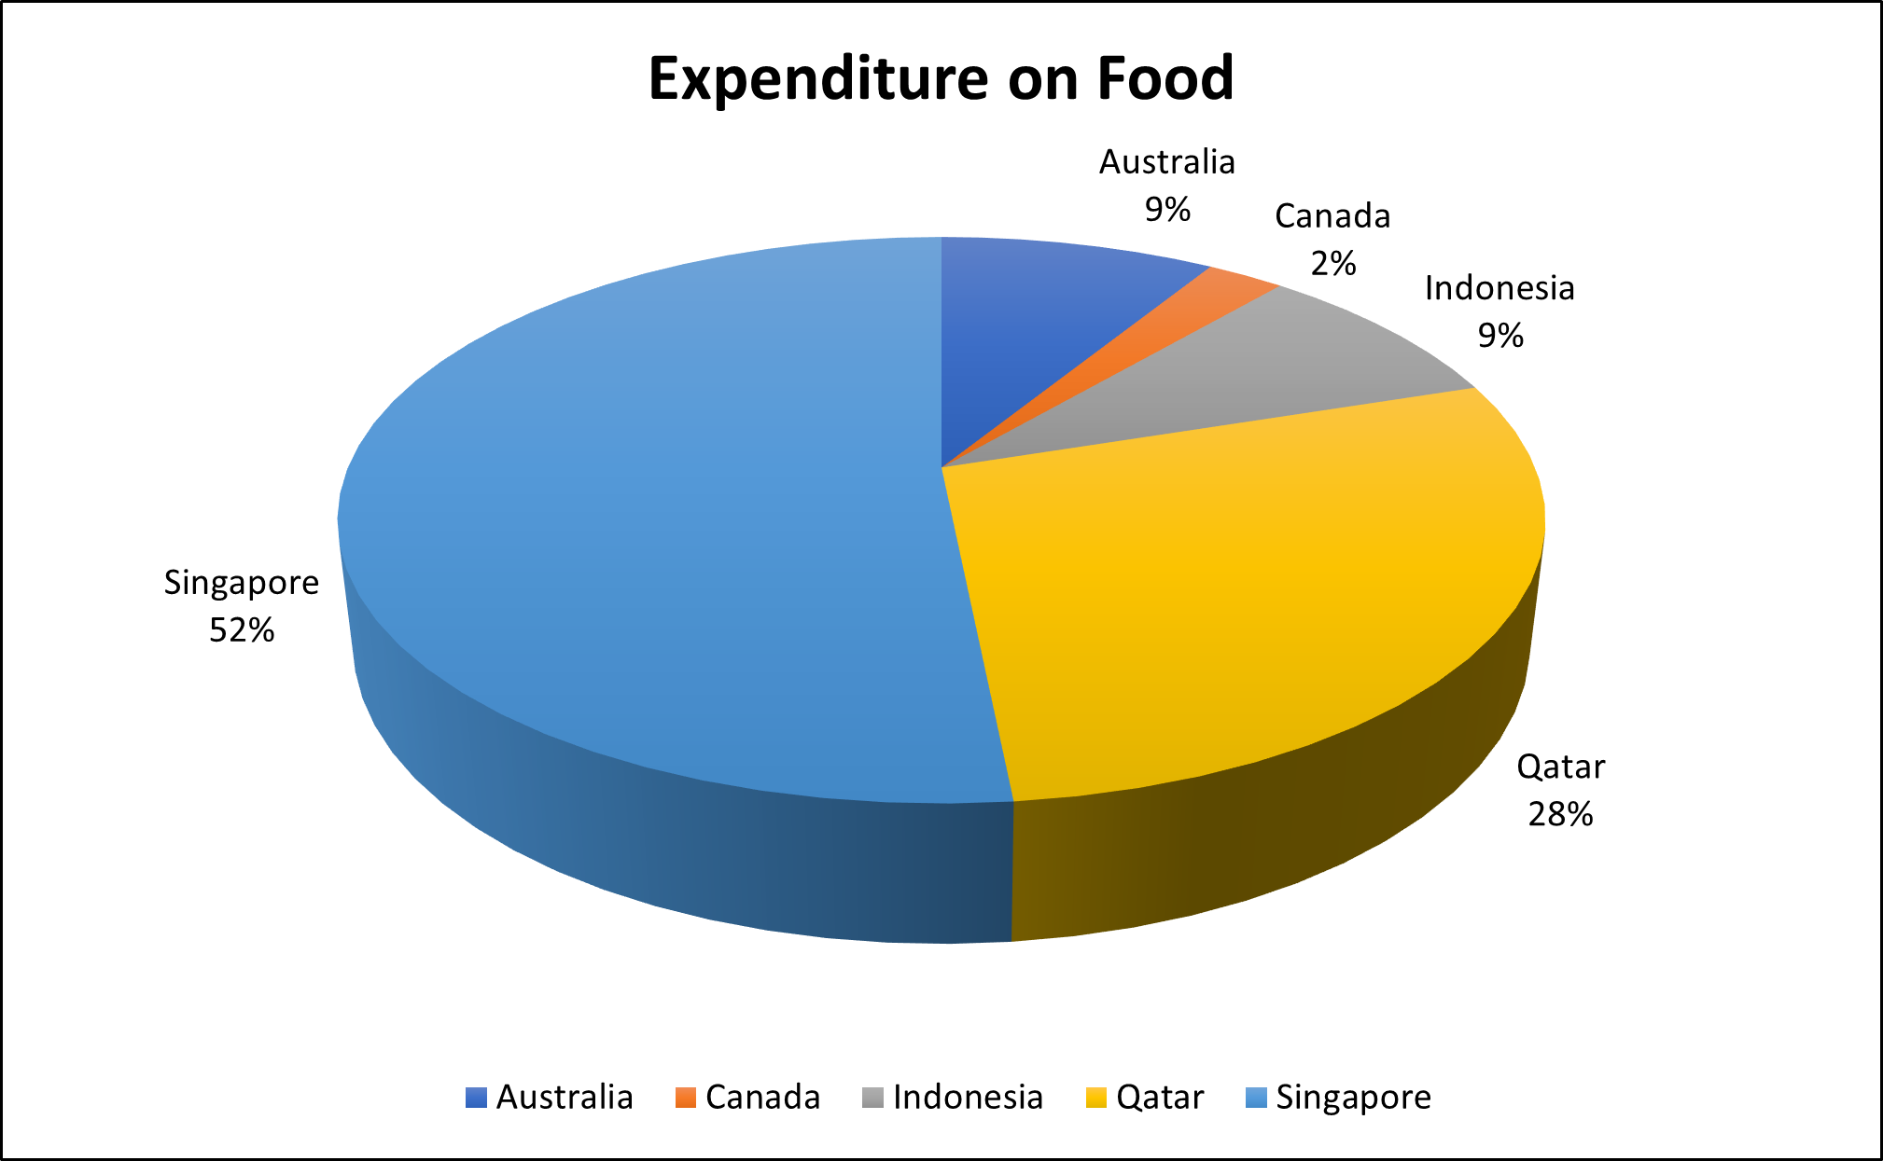

Total Expenditure on Foods

Slide 9

Biggest Competitors in Suggested Countries
Canada
Australia
Singapore
Consort Restaurant
Pier 70
Poets Cafe
Star Buffet
Makansutra Gluttons Bay

Slide 10
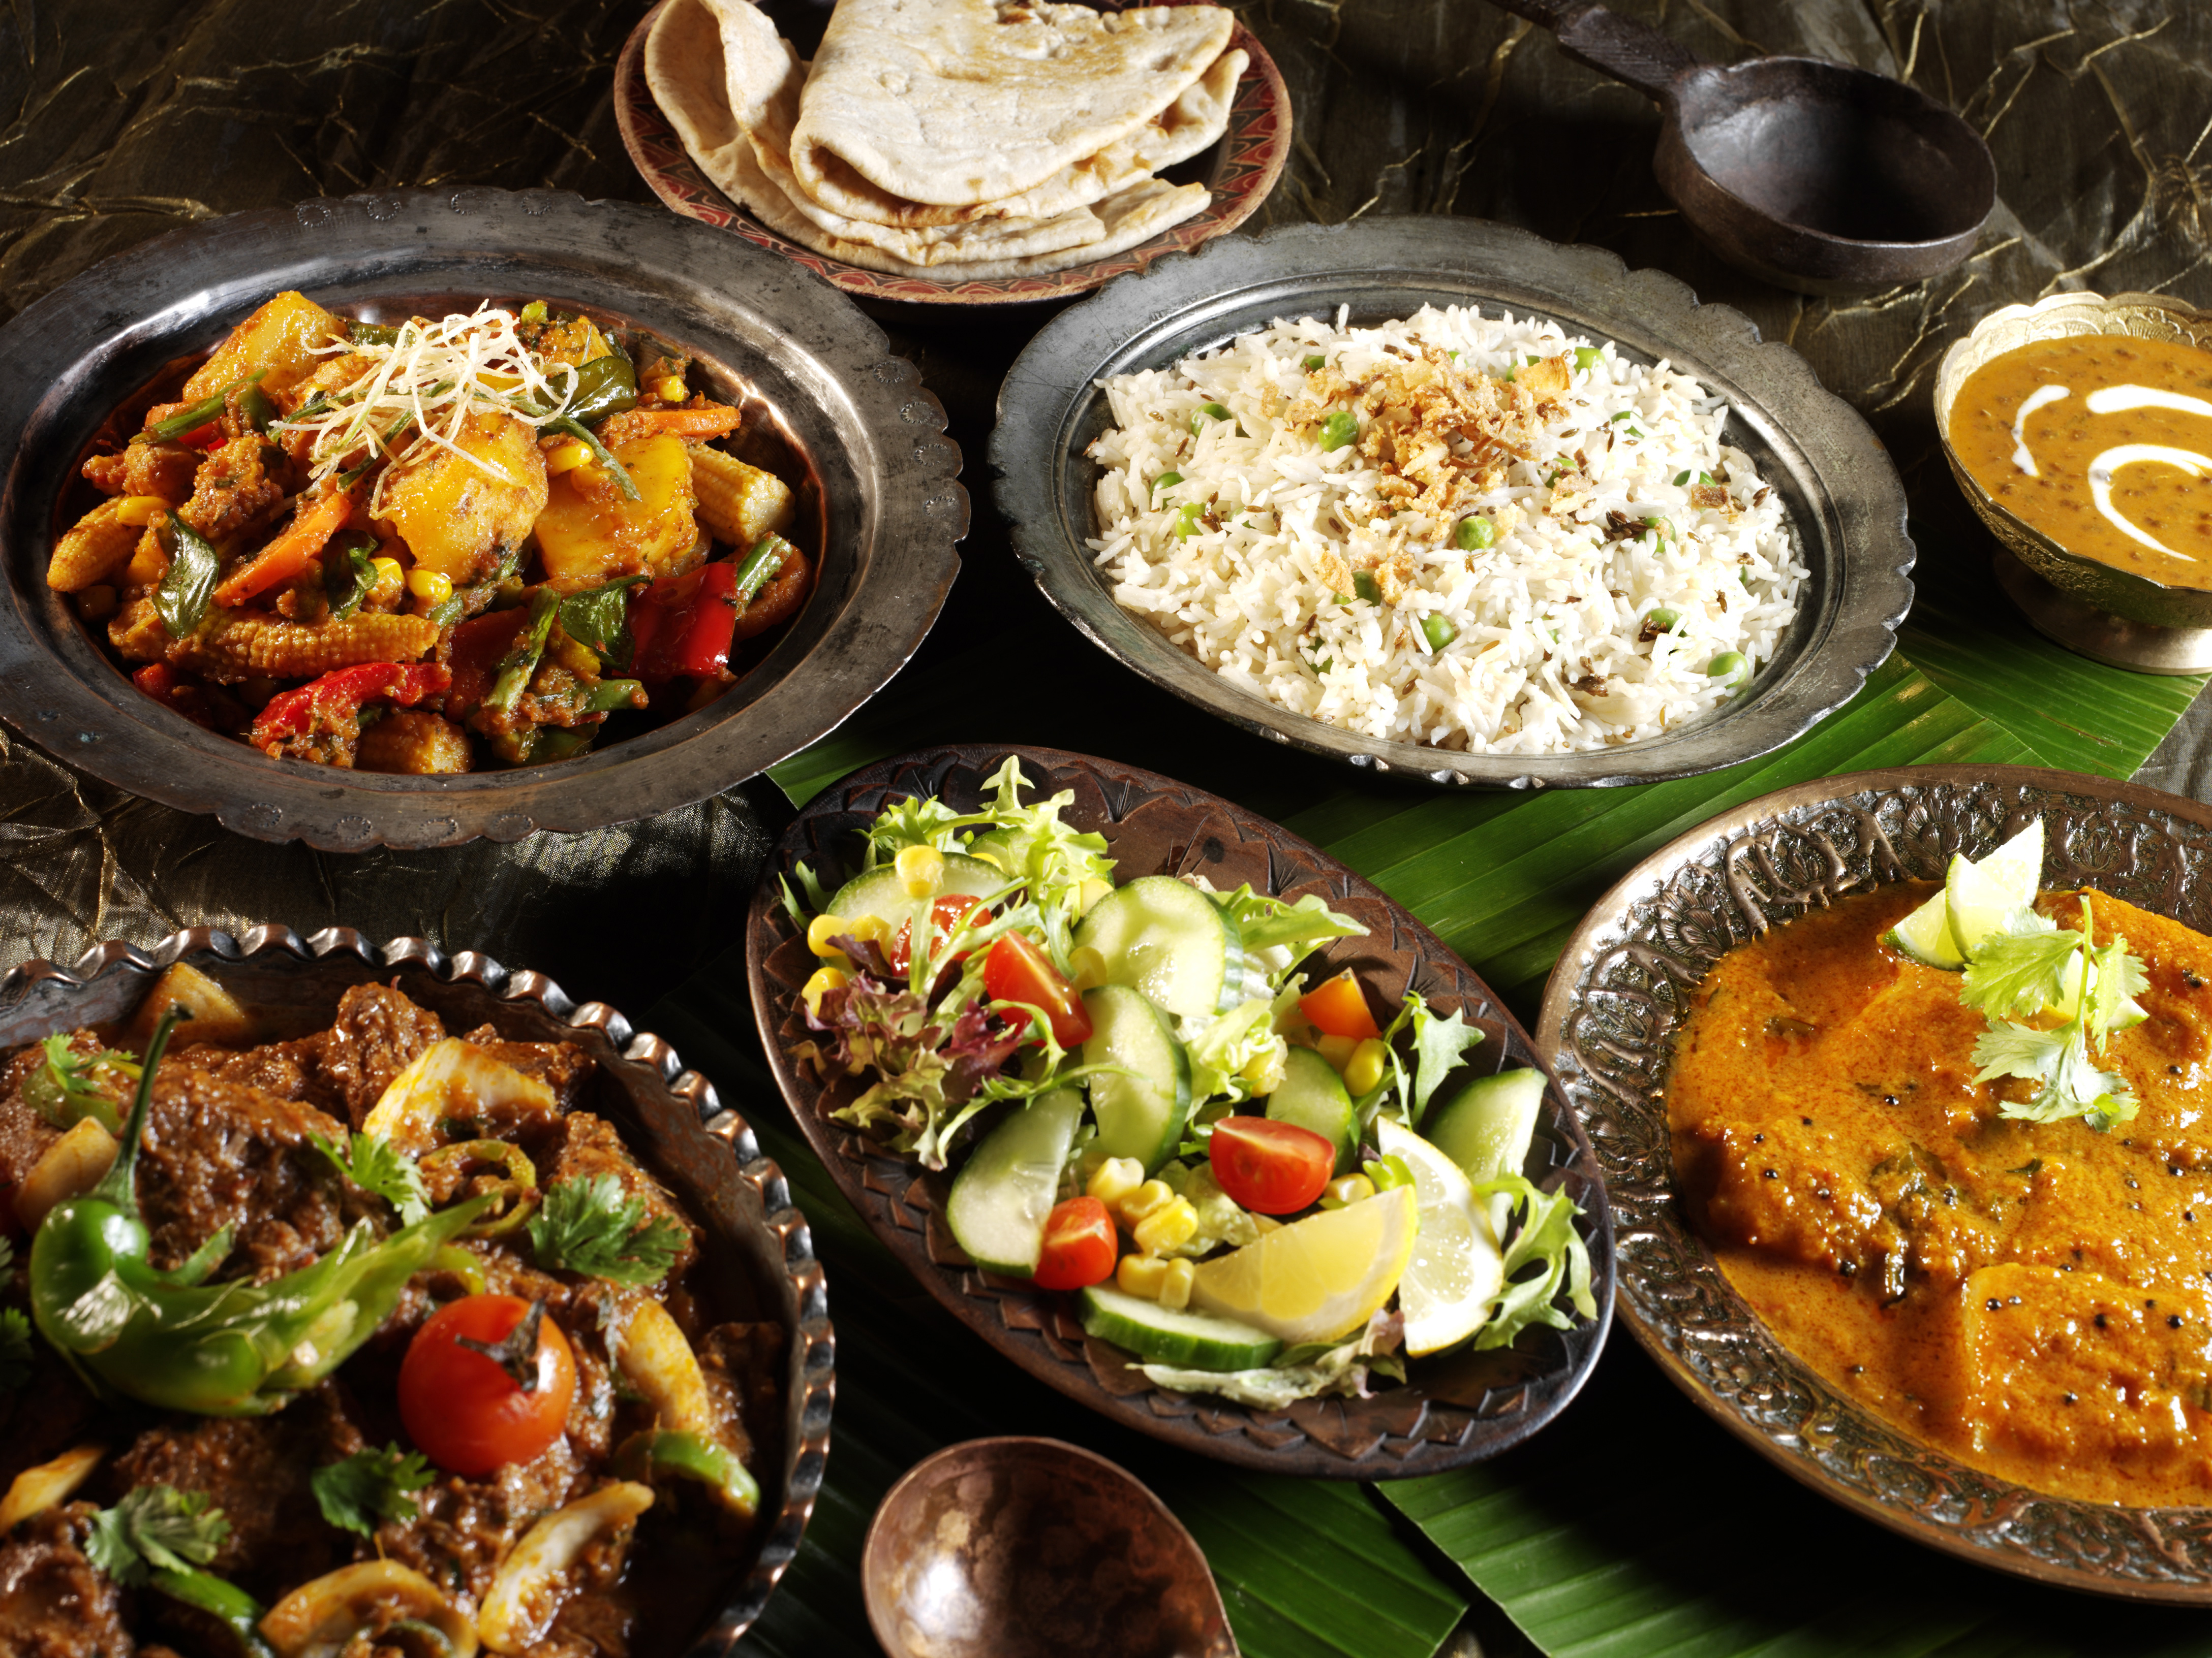

Choice of Cuisines
According to my analysis, the majority of individuals prefer their local cuisine over foreign cuisines, and restaurants that serve local cuisine and have higher ratings tend to receive better feedback. Thus, I've chosen a few regional dishes as well as a few more that received better reviews.

Slide 11


Mode of Booking
According to the research, none of the restaurants in the countries were using Online or Table booking service. It appears to be a fantastic opportunity to take advantage of. Here restaurants have the opportunity to provide additional booking options to customers in an effort to improve customer satisfaction and build a loyal following.
Online Booking
Table Booking

Slide 12
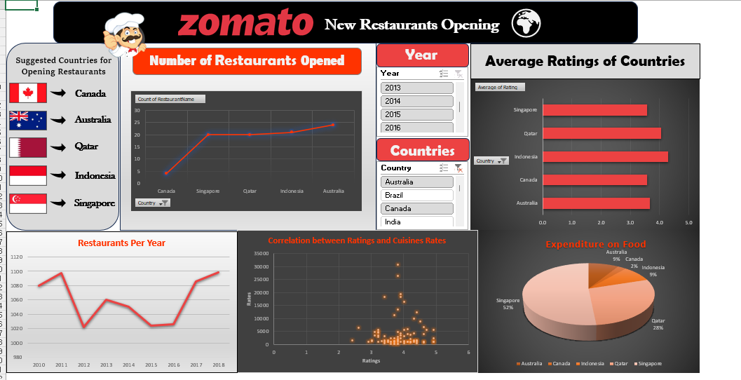
Dashboard

Slide 13
Thank You!

